Slide 1
MAD ABOUT MODULES
ORGANIZING MODULES TO FIT YOUR COURSE NEEDS
Notes:
One of the best practices when developing a Canvas course is to utilize modules to organize the learning for your students. Why are Modules so great? So many reasons!

Slide 2
Why Modules?
Organization
Teacher control
Access to materials
Flow of learning
Less clicks for students
Easy access to learning materials
Click here to watch a video presentation of this slideshow.
Notes:
They’re great because Modules allows teachers to organize and manage the content in a way that makes sense for their class. This includes when and how the students access the materials.
They’re great for students because they only have to go to one area of Canvas to see all their learning materials. Since nearly every feature of Canvas, from Content Pages to Quizzes, can be incorporated into in a module, this means fewer clicks (and fewer distractions) to get to the learning materials.
.

Slide 3
Module Considerations
Content chunks
Progression of the learning: Linear or Open?
Prerequisite knowledge
Naming conventions
Student needs
Notes:
How to best organize your modules is up to the individual teacher, based on the needs of the class. Consider the following:
How do you currently chunk the content? By unit or topic, by standard, by weeks at a time?
How linear is the progression of the learning? Can students dive to any resource at any point or is there a preferred order to the learning activities?
Is there anything that would be considered a prerequisite before building on that knowledge with new content?
As you name items within your module, use the same terms and phrases that you use in class with your students.
As always, consider the audience and the age-appropriateness of the organization.
This presentation will share a few popular options for module structure. Keep these considerations in mind about your own course so you can organize your Modules to best meet your needs.

Slide 4
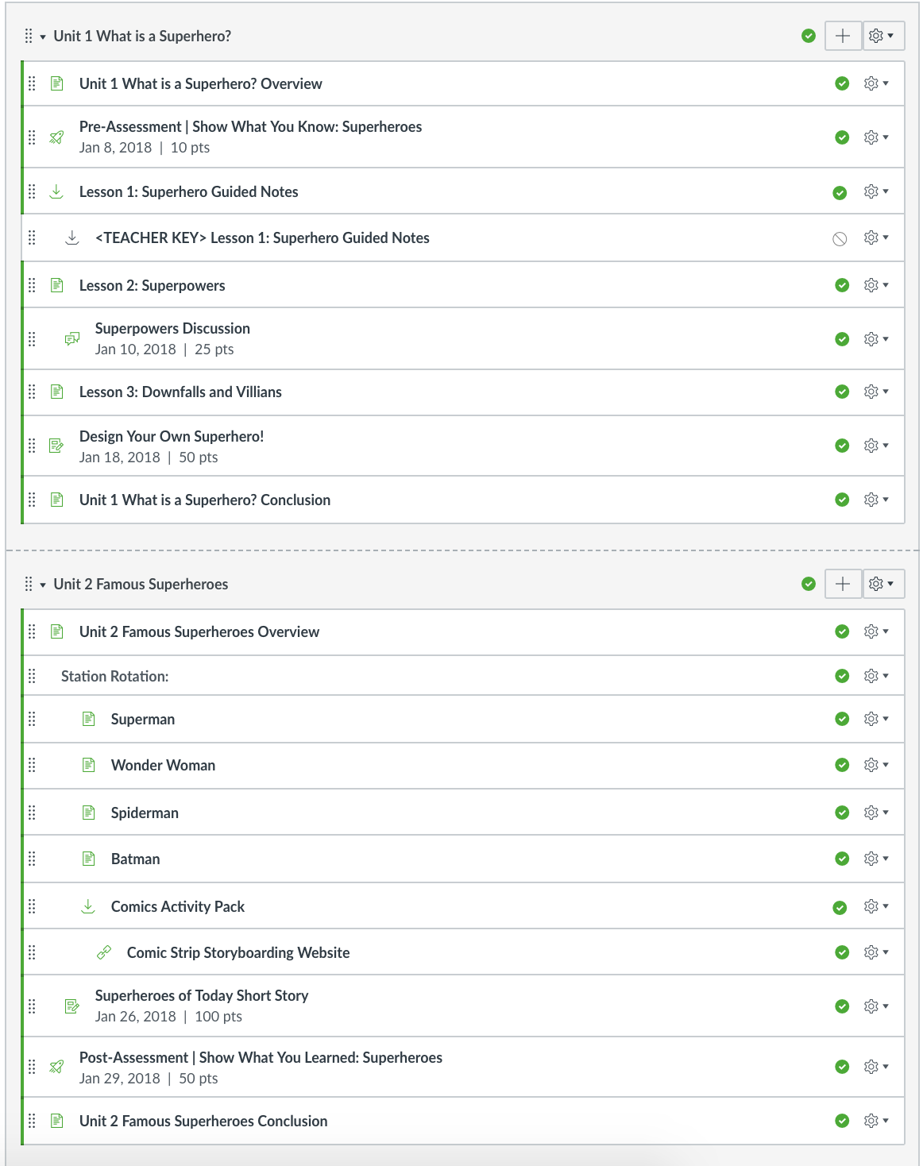
Modules by
Unit or Topic
Best for:
Classes that are organized into topics
Linear progression of learning
Open access to resources
Notes:
A popular structure to modules is to name the module after a specific topic or unit.
Items within the module can be broken down further into subtopics or sub-lessons through the use of text headers within the module.
Indenting is helpful so the users can see an outline view of the learning resources.
The teacher can control the release of items within the module by leaving items unpublished until they are ready for student access. For example, in Unit 1, the key of the notes is shown in the module as unpublished, so the teacher has access but the students do not. If the key is published, students would be able to view it.
The use of modules by unit or topic works well regardless of the intended flow of the learning activities. It works for items that should be progressively moved through in a linear fashion, or for items that are open to access anytime.
Students can refer back to resources within this module when they are looking for info about a particular topic.

Slide 5
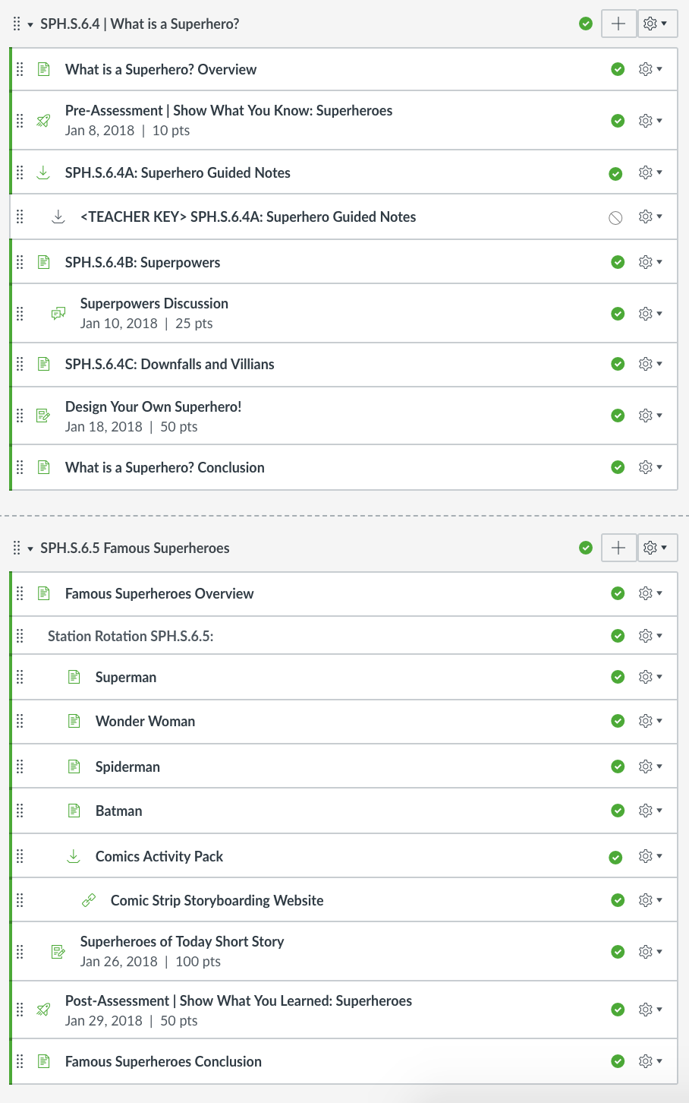
Modules by
Standard
Best for:
Classes that are organized with specific learning standards
Linear progression
Open access
Notes:
Organizing your Modules by specific learning standard is a good structure for classes that refer to the standards often or those classes that have specific standards directly tied to each of their learning activities.
This is similar to organizing modules by unit or topic, just a slight shift in the naming convention.
Modules by Standard work regardless of the intended flow of the learning activities, whether that is linear or open access.

Slide 6
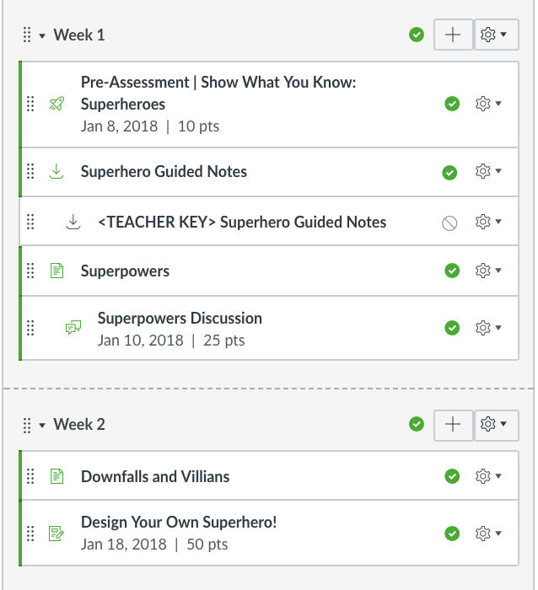
Modules by Chronology
Best for:
Classes that are organized by time period
Ordered progression
Lots of student interaction
Notes:
Modules can also be structured chronologically, by a time period, such as a week.
Items within the module follow an ordered progression. This structure works well if the students are interacting with the content regularly, such as turning in daily or weekly assignments.

Slide 7
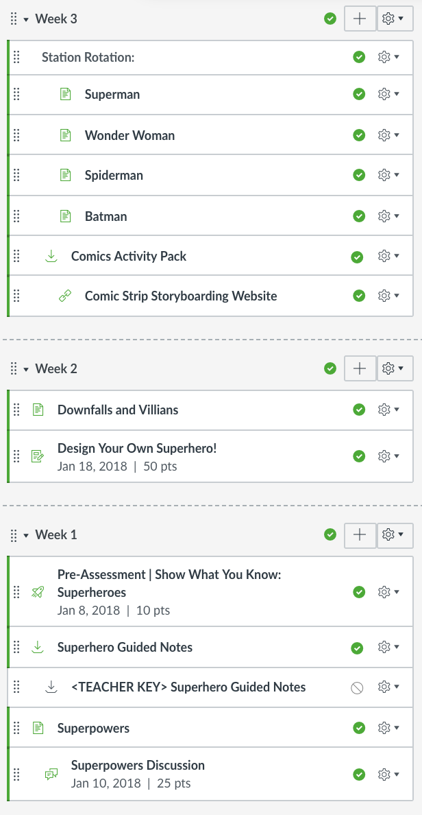
Re-Ordering Module Content
Notes:
Remember that modules and even items within the module can be ordered and re-ordered so that the most recent activity is shown at the top. This eliminates users from scrolling through a bunch of information to find what they are looking for.

Slide 8
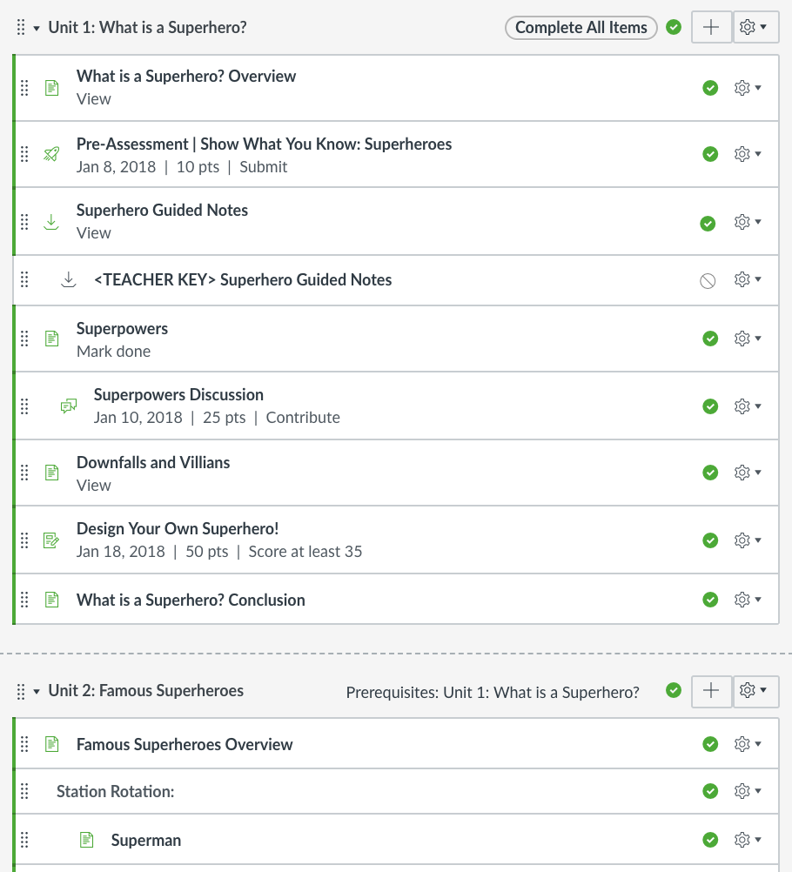
Modules with
Pre-Requisites & Requirements
Best for:
Linear progression
Controlled flow of content
Works for any module organization style
Notes:
Regardless of your chosen organization, Modules can have items within it that are “required” of students.
Requirements are noted in gray beneath the name of the Module item, shown here as View, Submit, Mark Done, Contribute, or Score at Least a certain score.
Prerequisites can be set up for every module except the first module. Here, unit 2 has a prerequisite of completion of unit 1. That means students must have completed all the requirements in Module 1 before they would be able to view the content of module 2.
The best practice is to build the entire module and then set requirements within the module settings. Specific requirements can be set for any or all items, in a particular order or with no particular order..
Linear requirements are not recommended for modules in which you want to students to be able to openly access any information.

Slide 9
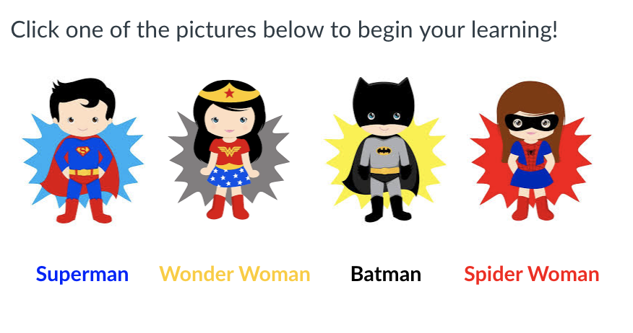
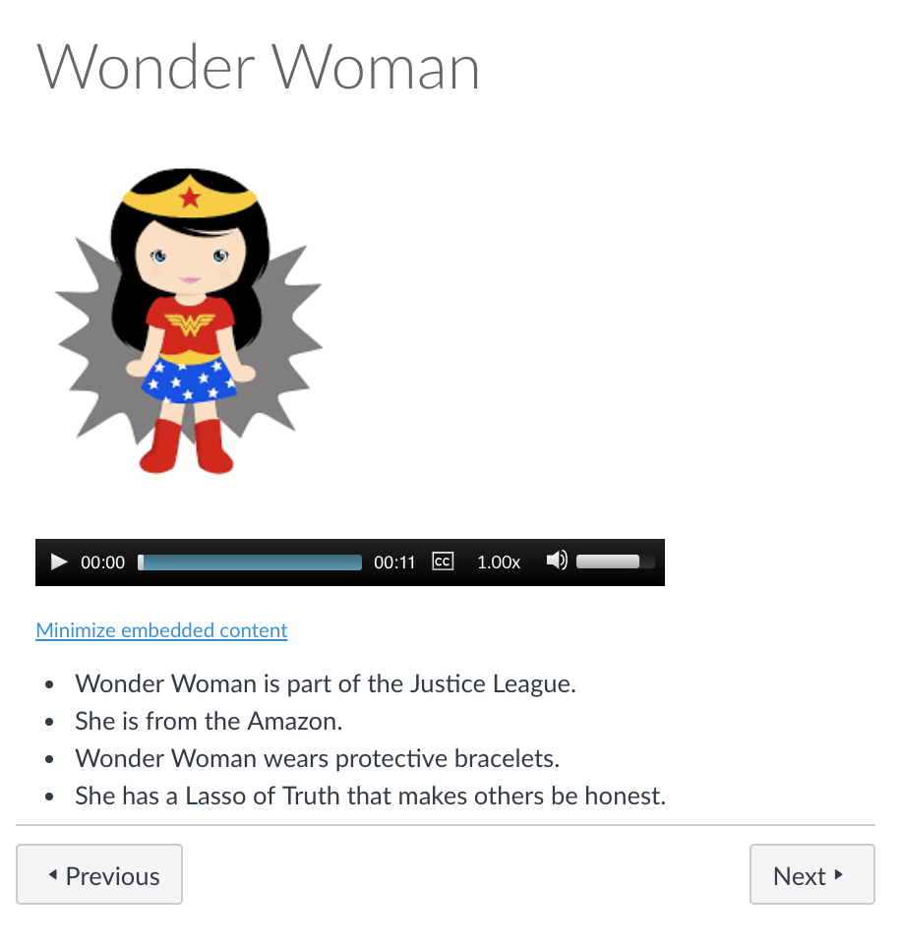
Modules for Young Learners
Recommendations:
Early childhood classrooms
Use images
Link to items
Navigate with Next and Previous buttons
Notes:
For classrooms in which the students are still developing in reading skills, one recommendation is to include images on the homepage that link them directly to an item within a module. By clicking the image, the content will open with the next and previous arrows to navigate through the learning activities.

Slide 10
To learn more, check out guides.canvaslms.com
Notes:
To learn more, explore the Canvas guides at guides.canvaslms.com.

Slide 11
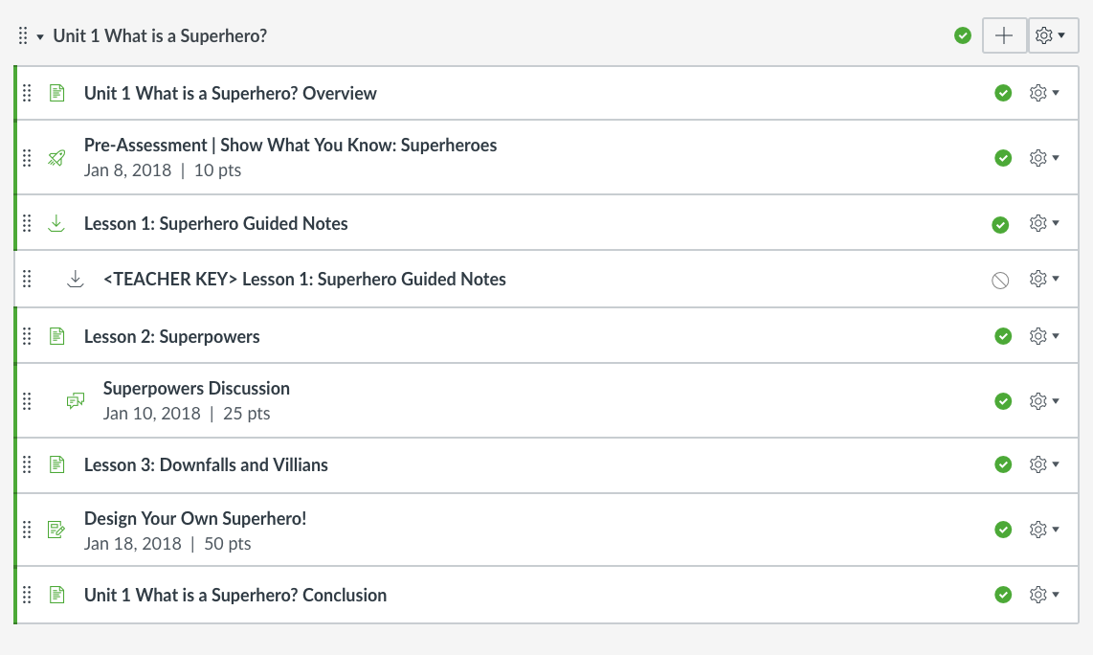
Modules by
Unit or Topic
Best for:
Classes that are organized into topics
Linear progression of learning
Open access to resources
Notes:
A popular structure to modules is to name the module after a specific topic or unit.
Items within the module can be broken down further into subtopics or sub-lessons through the use of text headers within the module.
Through the use of indenting, the users can see an outline view of the learning resources.
This set up works regardless of the intended flow of the learning activities. It works for items that should be progressively moved through in a linear fashion, or for items that are open to access anytime.
Students can refer back to resources within this module when they are looking for info about a particular topic.

Slide 12
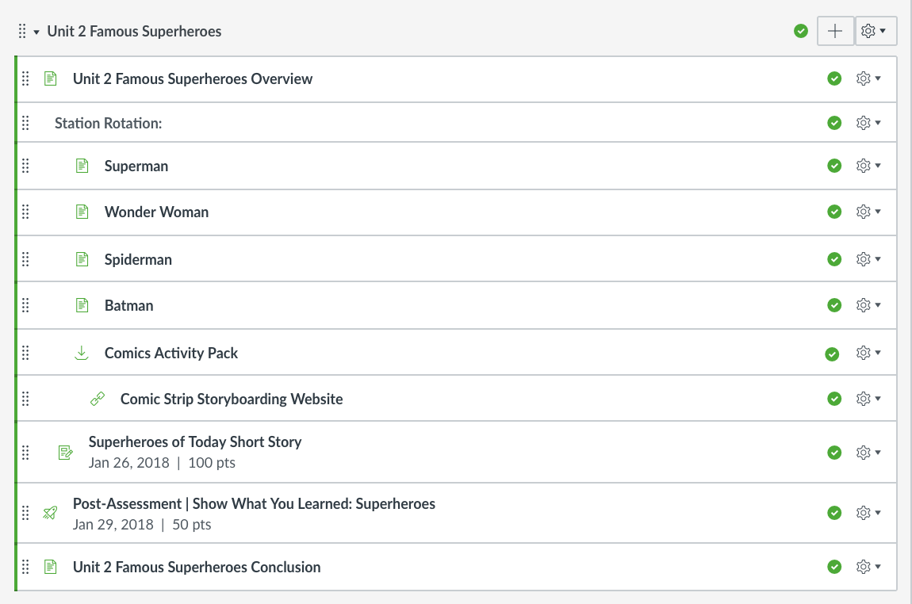
Modules by
Unit or Topic
Best for:
Classes that are organized into topics
Linear progression of learning
Open access to resources
Notes:
A popular structure to modules is to name the module after a specific topic or unit.
Items within the module can be broken down further into subtopics or sub-lessons through the use of text headers within the module.
Through the use of indenting, the users can see an outline view of the learning resources.
This set up works regardless of the intended flow of the learning activities. It works for items that should be progressively moved through in a linear fashion, or for items that are open to access anytime.
Students can refer back to resources within this module when they are looking for info about a particular topic.

Slide 13
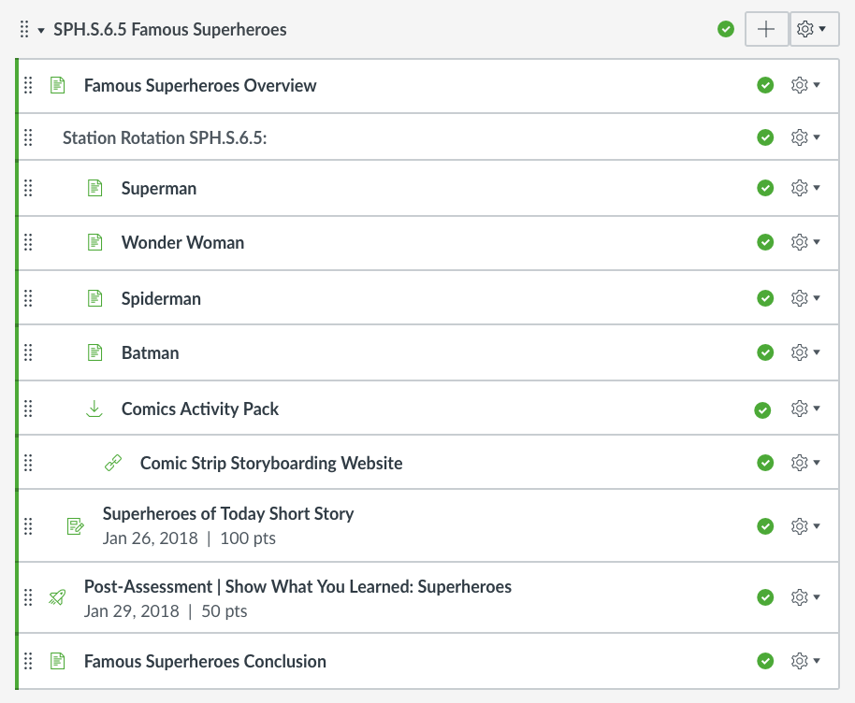
Modules by
Standard
Best for:
Classes that are organized with specific learning standards
Linear progression
Open access
Notes:
Organizing your Modules by specific learning standard is a good structure for classes that refer to the standards often or those classes that have specific standards directly tied to each of their learning activities.
This is similar to organizing modules by unit or topic, just a slight shift in the naming convention.
Modules by Standard work regardless of the intended flow of the learning activities, whether that is linear or open access.

Slide 14
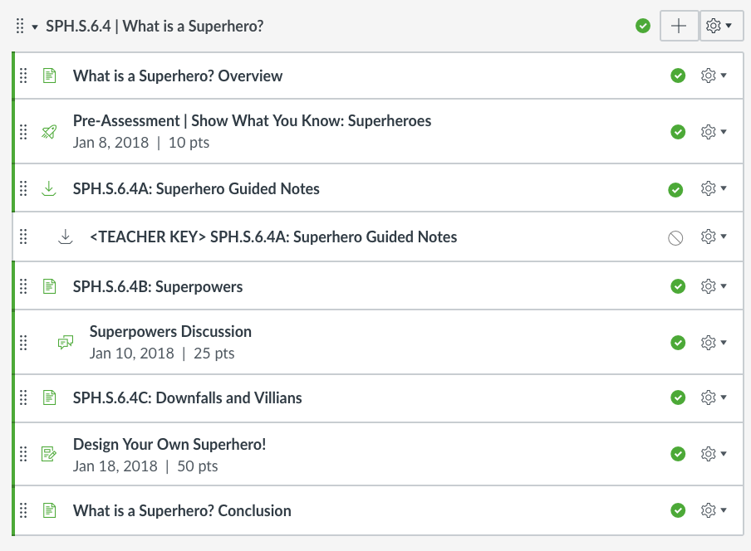
Modules by
Standard
Best for:
Classes that are organized with specific learning standards
Linear progression
Open access
Notes:
Organizing your Modules by specific learning standard is a good structure for classes that refer to the standards often or those classes that have specific standards directly tied to each of their learning activities.
This is similar to organizing modules by unit or topic, just a slight shift in the naming convention.
Modules by Standard work regardless of the intended flow of the learning activities, whether that is linear or open access.

