Slide 1
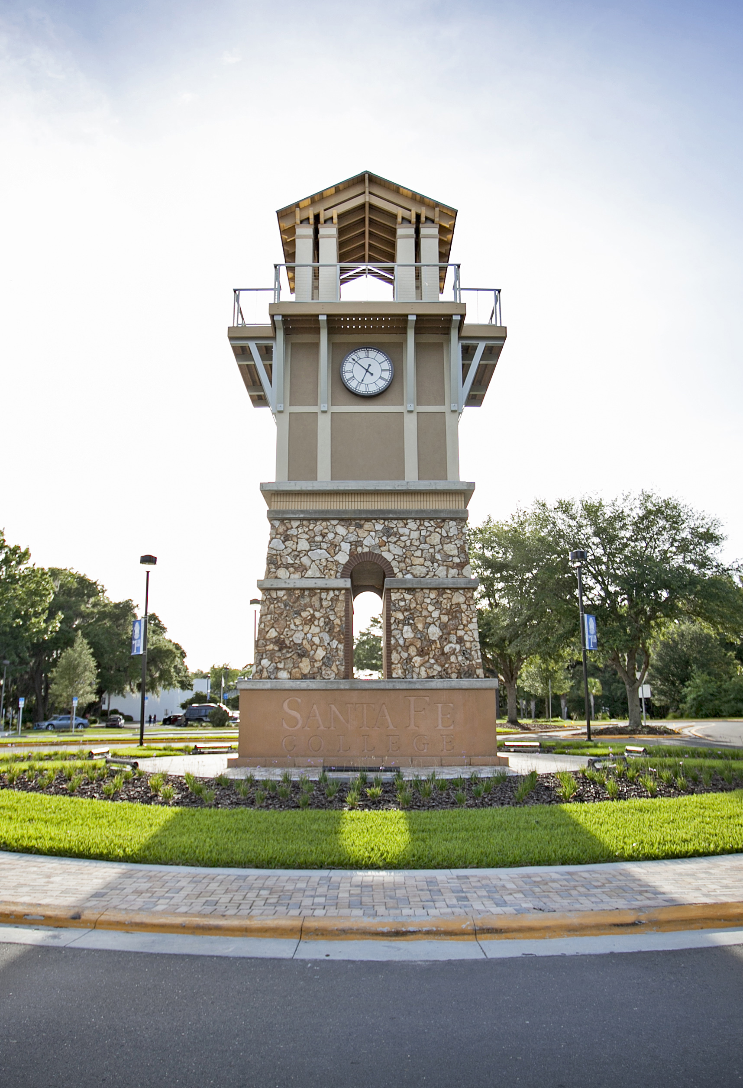
Course Name Instructor Name
Please wait for the session to begin. Class begins at:
Enter time here
While you wait, select the arrow to the right of the microphone button to adjust your audio settings.
Notes:
Instructor tips: Arrive a few minutes early and share this presentation.

Slide 2
The session has started. You should be hearing the presenter’s voice.
If you cannot hear the presenter, try adjusting your computer volume and look for volume controls on your ear buds or headphones.
Notes:
Wait about a minute while on this slide for students to make adjustments. Prompt students: if you can hear me, please type “Yes” into the chat box.

Slide 3
The session is being recorded.
If you are not able to fully participate in the live session, your instructor will provide you with a recording of this session.
Notes:
This is also a reminder to start recording, if you haven’t done so already.

Slide 4
Zoom meetings are best experienced using a laptop or desktop computer.
You may not be able to view all content if using a smaller device such as a smart phone.
Notes:
Remind students to use a laptop or desktop if possible.

Slide 5
Slide Title
Your content
Your content

Slide 6
End of Webinar
Thank you for coming today!

