Slide 1
Facilitating Online Learning
Jason Frank EdD

Slide 2
The Courage to Teach
“Good teaching cannot be reduced to technique; good teaching comes from the identity and integrity of the teacher.”
- Parker J. Palmer

Slide 3
Outcomes
Articulate the connection between trust and learning
Identify several Daily, Weekly, and Quarterly Habits that every online instructor should develop
Name 3 online practices that will build trust
Employ multiple approaches for giving feedback
Develop a brief biography that showcases both knowledge of and enthusiasm for your field of study

Slide 4
Vulnerability
Staying vulnerable is a risk we have to take if we want to experience connection. -Brene Brown
Notes:
When we take risks we are making ourselves vulnerable.

Slide 5
A Pedagogy of Kindness
Notes:
It can be a little more difficult to see the humanity of our students in online environments unless we make deliberate efforts to do so. There is a reason that trolling is so prevalent online. We can dehumanize individuals more easily when we only see their avatars and they only see ours.
https://hybridpedagogy.org/pedagogy-of-kindness/
See also: Do you trust your students? https://hybridpedagogy.org/do-you-trust-your-students/

Slide 6
Organization builds trust
Notes:
When students can focus on navigating the content and achieving learning outcomes rather than navigating the course and using the technology, they will be more successful and they will have more trust in you as an instructor. Unclear expectations and a disorganized learning environment can undermine your relationship with students. Create patterns that repeat and introduce technology early with low stakes assignments.

Slide 7
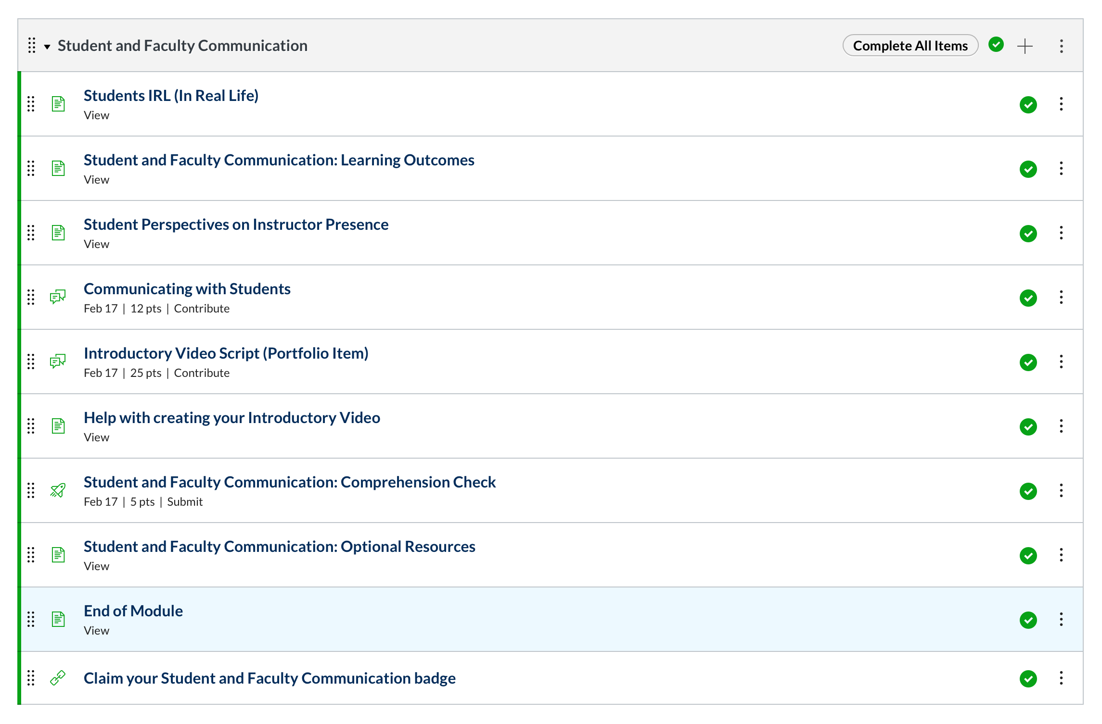
Modules in Canvas
Create a pattern that repeats
Clearly label each page
Contextualize content
Use signposts
Notes:
Show modules

Slide 8
Transparent Assignments
Notes:
Communicate and be explicit. Clarity is kindness. Remember that students can’t easily probe for clarify expectations. The more information you can give, the better you can scaffold, the more likely the student will succeed. They will also trust you. Rubrics and samples are particularly helpful in this regard.

Slide 9
Assignments in Canvas
Using rubrics
Include all of the necessary information on the assignment page.
Make sure students understand the technical requirements for the assignment.
Notes:
Canvas Assignment with Rubric

Slide 10
Online Instructor Habits and Routines
Beginning of Semester – Introduction, Set Expectations
Daily – Emails and Discussion Check-In
Weekly - Announcements, Checking participation, Grading
Mid-Semester – Soliciting Student Feedback, View Grades
End of Semester – Review Grades, Enter Grades, Final Message
Notes:
One of the obstacles for online students is creating routines that support their learning. The asynchronous nature of most online courses, gives students and instructors a lot of freedom and sometimes that can be a little paralyzing. Creating a routine for ourselves, systemizes a lot of the administrative aspects so you can focus on students and learning. You need to figure our what works for you, but once you have

Slide 11
Online Facilitation Guide
Presence
Active Learning
Feedback and Student Interactions
https://www.sfcollege.edu/cat/guides/online-facilitation
Notes:
Sheet over head ghost image.

Slide 12
Presence

Slide 13
Notes:
Show your face. Students should be able to recognize you on the street. The temptation towards anonymity is understandable but it will impact your relationship with your students. Consider adding a photo (that is relatively current) to your home page. Acknowledge studies of women and people of color. Acknowledge your place of privilege. Discuss how CODI assignment 1 and our first try – we didn’t realize.

Slide 14
Notes:
Should you friend your students? Consider using social media as another point of contact. I recommend against using your personal account, though.

Slide 15
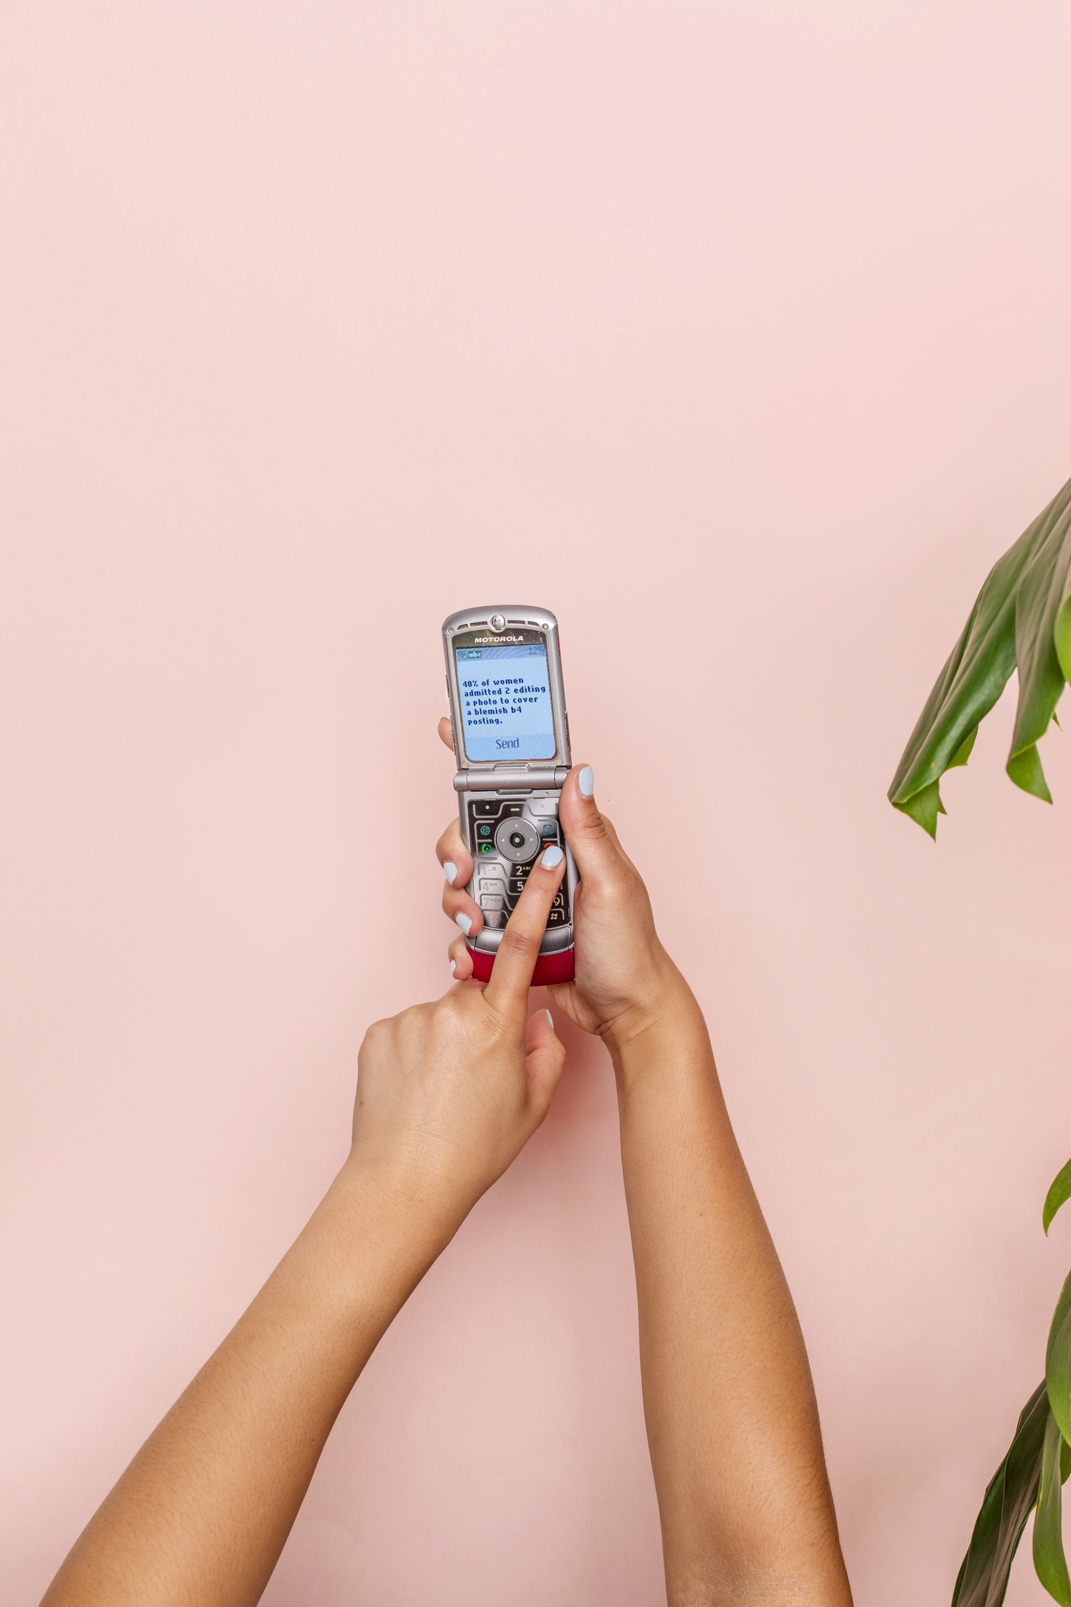
Notes:
Should you give students your cell? Poll

Slide 16
Your Bio
How did you discover your field. What do you love about it?
Describe your educational and professional journey.
How is your life better for knowing what you know?
What do you want people to know about your interests, family, hobbies?
Notes:
Give participants a few minutes to reflect and answer these questions.

Slide 17
Notes:
Hobbies and Interest: Personal Quirks can get a lot of mileage. My Lego College – Star Wars Lego can cover multiple bases. Video games, books, movies. It is vulnerable

Slide 18
Instructor Videos
mere-exposure effect
confirmation bias
it’s difficult
Notes:
https://www.sparcstart.com/the-psychology-behind-video-phobia/
“asserts that people react more favorably to things they see more often. Since we see ourselves most frequently in the mirror, this is our preferred self-image. According to the mere-exposure effect, when your slight facial asymmetries are left unflipped by the camera, you see an unappealing, deformed version of yourself.”
These are difficult and these are important.
Students do expect to be able to see you. Can you imagine teaching your course.

Slide 19
Videos in Canvas
Notes:
What does it look like in Canvas. Record directly or embed from youtube or some other hosting site. What I do is…

Slide 20
Active Learning

Slide 21
Notes:
Active Learning: Nothing undermines trust and confidence like multiple choice quizzes. Your assignments the creativity that goes into them, tells students a lot about you. The way you teach is another way to establish presence. When you focus on active learning, ways in which students are encouraged to engage deeply with the subject matter, you are encouraging deeper learning and by extension showing students how much
See: https://www.insidehighered.com/blogs/higher-ed-gamma/making-online-learning-active?utm_source=Inside+Higher+Ed&utm_campaign=adffa771a4-DNU_2020_COPY_01&utm_medium=email&utm_term=0_1fcbc04421-adffa771a4-200224249&mc_cid=adffa771a4&mc_eid=a5248b24df
https://catlintucker.com/2020/07/8-ideas-designed-to-engage-students-online/?fbclid=IwAR3TM38LV_T6yhgnT3f2d2K4ehaXuZ0N_xCsYbeWu60LyE3q6xALiccXiBo

Slide 22
Feedback and Student Interactions

Slide 23
Emails and Your Response Window
Notes:
Write out your policy. How do you want students to communicate? How will you respond? How long will it take you to respond? Are there exceptions? Typical grading turnaround–This should go on your syllabus, but it’s important enough to put on your homepage too (or somewhere else) – Give participants a few minutes to compose this. Do what you say. If something happens to affect response times, communicate through announcements.

Slide 24
Discussion Boards
Ask specific and unexpected questions
Participate frequently
Strive to continue the discussion rather than end it
Provide clear guidelines on participation and etiquette.
Promote meaningful participation

Slide 25
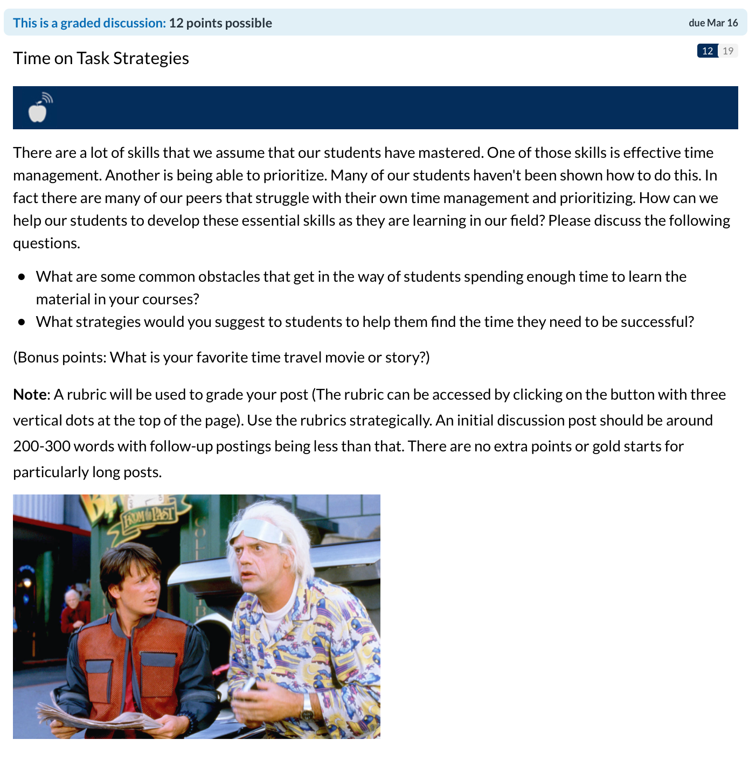
Discussions in Canvas
Notes:
Canvas Examples

Slide 26
Feedback
Rubrics and Speedgrader
Email
Discussion Posts
Announcements
Text, Audio, Video

Slide 27
Notes:
Know their names and faces. It has been pretty focused on instructors. This is all designed to be student centered. One of the easiest and most effective ways to connect with students is to know their name.

Slide 28
Notes:
Warm Tone. Are you an advocate for your students? Do they know it? How do you communicate your desire for their success?

Slide 29
Authenticity
Authenticity is a collection of choices that we have to make every day. It’s about the choice to show up and be real. The choice to be honest. The choice to let our true selves be seen.
– Brene Brown
Notes:
Why does authenticity matter in an online context? In what ways have social media encouraged inauthentic behaviors? How do we maintain integrity and authenticity as instructors?

Slide 30
Man in the Arena
Notes:
This is what I want at the end of the course. I want you to show up. It is, in many ways easier, to hide in a online course. This is especially true if you are using a lot of publisher content. You are critical to the learning process. Showing up is brave.

Slide 31
Canvas Help
Email - Make an appointment for one-on-one assistance or ask a question – canvashelp@sfcollege.edu
Phone - Call us from 8 a.m. - 4:30 p.m. to speak to one of the Canvas experts – 352-395-7344
Zoom Support - from 8 a.m. - 4:30 p.m https://sfcollege.zoom.us/j/288173136
Problem Report – You can submit a problem report at any time. One of the Canvas experts will respond as quickly as possible, but it may take as long as 24 hours when the college is closed.
Notes:
Our team is ready to support you in this.

Slide 32
Questions and Comments

