Slide 1
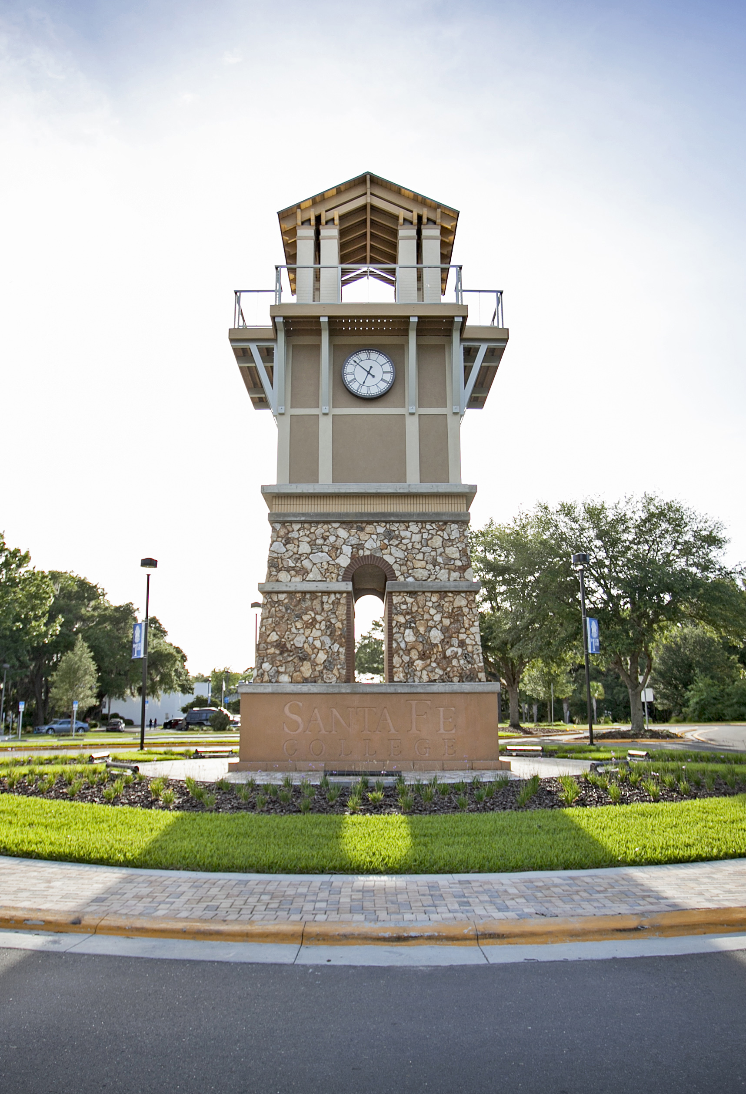
Online Design (Self-Paced)
Please wait for the session to begin. Session begins at:
X:XX xm
While you wait, select the arrow to the right of the microphone button to adjust your audio settings.
Notes:
Instructor tips: Arrive a few minutes early and share this presentation.

Slide 2
Today’s Goals
Define common terms related to online instruction
Highlight practices for creating intuitive online courses
Demonstrate two video recording tools
Review aspects of the SF Online Course Design Checklist
Discover the beauty of the fabulous Florida Keys!
Note: this is the beginning of a conversation
Notes:
We recognize that one hour may not be sufficient to help you get immediately started teaching online. Please know that you will have ongoing support.

Slide 3
Notes:
It’s okay to be jealous. We’ll return to the Florida Keys later in this presentation.

Slide 4
Common Terminology
Alignment – ensuring your learning activities and assessments support your learning outcomes
Design - to plan, create and organize instructional materials and activities
Curate – leverage your expertise to select instructional resources
Facilitate - to administer, communicate, provide feedback, guide, and encourage
Synchronous – learning together at the exact same time
Asynchronous – more flexible learning over periods of time
Notes:
At Santa Fe College, most courses tend to be asynchronous because they provide greater flexibility to our students. You may want to check with your department if uncertain which model works best. If you choose a synchronous model, be sure to indicate any required virtual meeting times on your Course Information pages. Consider recording live web sessions.

Slide 5
Course Design Practices
Customizing your Canvas course menu
Creating a course home page
Organizing content within modules
Leveraging “sign posts” to guide learners
Creating rubrics when possible
Using a variety of media when possible
Creating multiple assessment opportunities

Slide 6
Customize Your Course Menu
Reduces screen clutter
Ensures quicker access to course content
Increases uniformity of SF courses
Let’s see how!

Slide 7
Generally Suggested Menu Items
Home
Announcements
Modules
Discussions
People
Grades
Canvas 101 (always recommended)
SF Policies and Resources (always recommended)
Your course needs may vary
Syllabus tool*

Slide 8
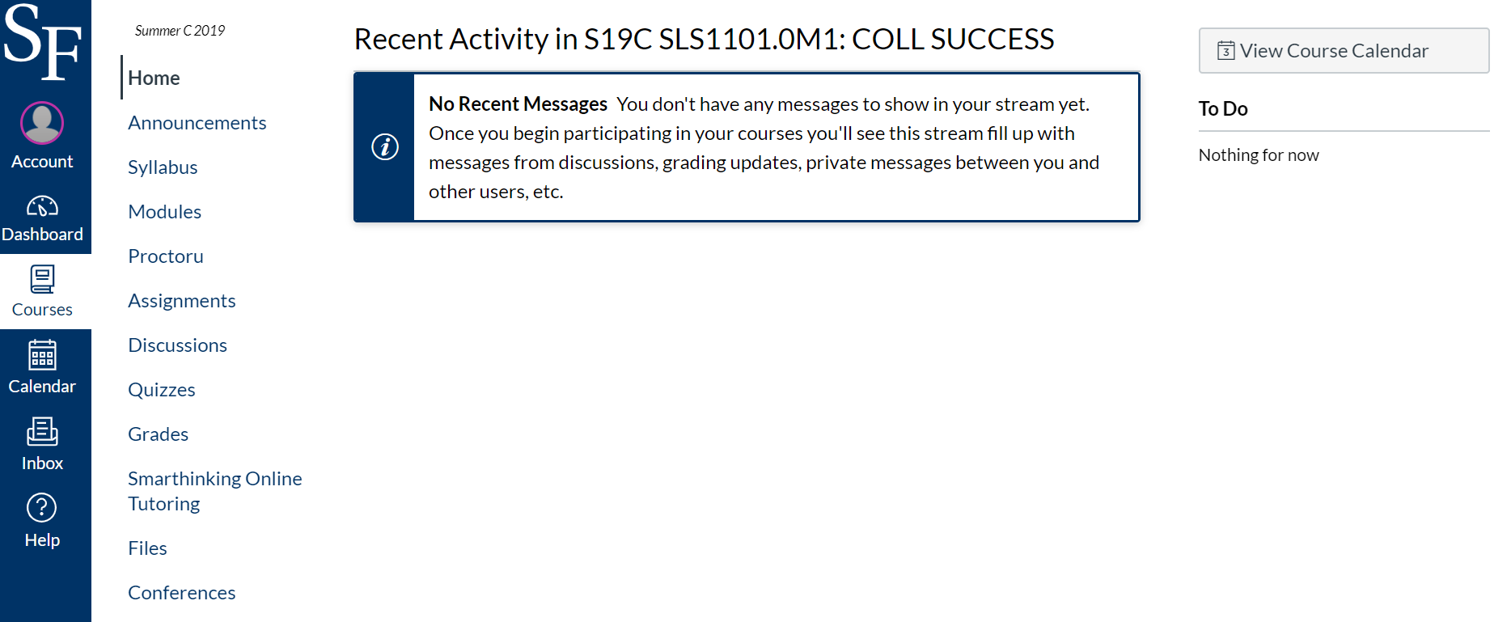
Canvas Home “Default” View
Above: The Canvas default home option is the “Course Activity Stream”

Slide 9
Benefits of a Home Page
Provides students with quick access to contact information
Increases uniformity across SF online courses
Gives students immediate confidence they are in the correct course
Allows for the creation of a warm and inviting starting point
Indicates where to go next for information

Slide 10
A brief message welcomes students. A clear message indicates that this an online course.

Slide 11
A course-relevant image can provide an obvious indication which course the student has entered.
Notes:
For a more personal touch, consider adding your own photo.

Slide 12
Providing your contact information at the outset can be beneficial to students unsure how to navigate the course.
Notes:
Students at SF often enroll in multiple courses. Some courses only utilize publisher-provided content, and therefore your course may like strikingly different from what some students are accustomed to seeing.

Slide 13
A brief statement indicates where students go next.
Notes:
Note: If you want students to click on the “Syllabus” option first, and then go to “Modules”, indicate that clearly here.

Slide 14
Notes:
An example from a colleague. We have to make a conscientious effort to use positive language.

Slide 15
Notes:
Another example

Slide 16
Notes:
Another example, no photo of instructor, but compelling image!

Slide 17
Organize Your Content within Modules
Adding your content into the “Modules” area of Canvas provides students with a seamless flow to access material
Students also benefit from the built-in navigation (“Next” and “Back”) buttons to navigate the content.
(Show example from SLS course)
Notes:
Browse SLS1101.0X1 online course point out modules. Modules allow for a seamless flow, and take advantage of Canvas’s built-in navigation buttons. While content can be organized in a variety of ways, the chronological method is most intuitive for students.

Slide 18
“Sign Posts”
Text or images that help students understand where they are in a course
Help students develop a “cognitive map” of the course
Provide opportunities to contextualize content

Slide 19
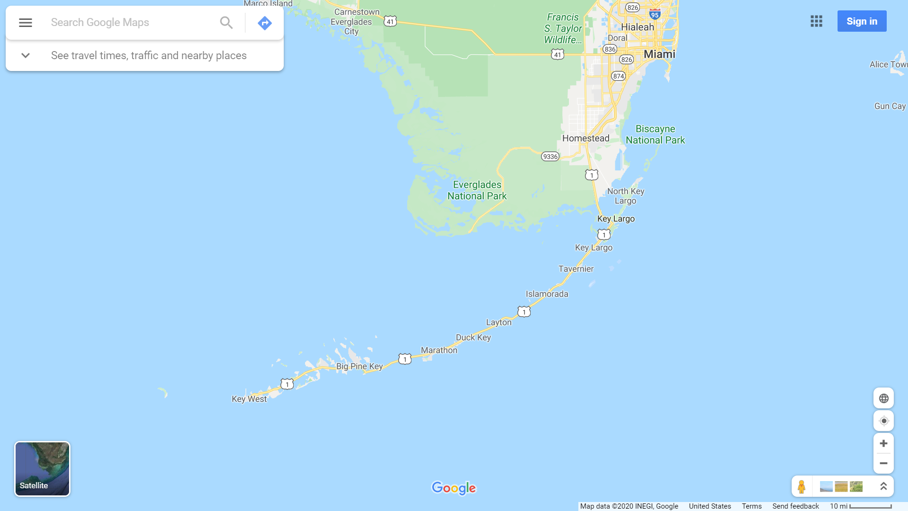
Notes:
Here’s my home town in the middle of the Florida Keys

Slide 20
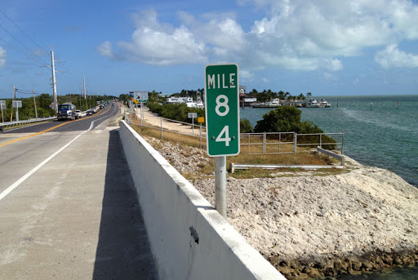
Notes:
In the Florida Keys, mile marker signs provide visitors with a very obvious indicator where they are on US 1.

Slide 21
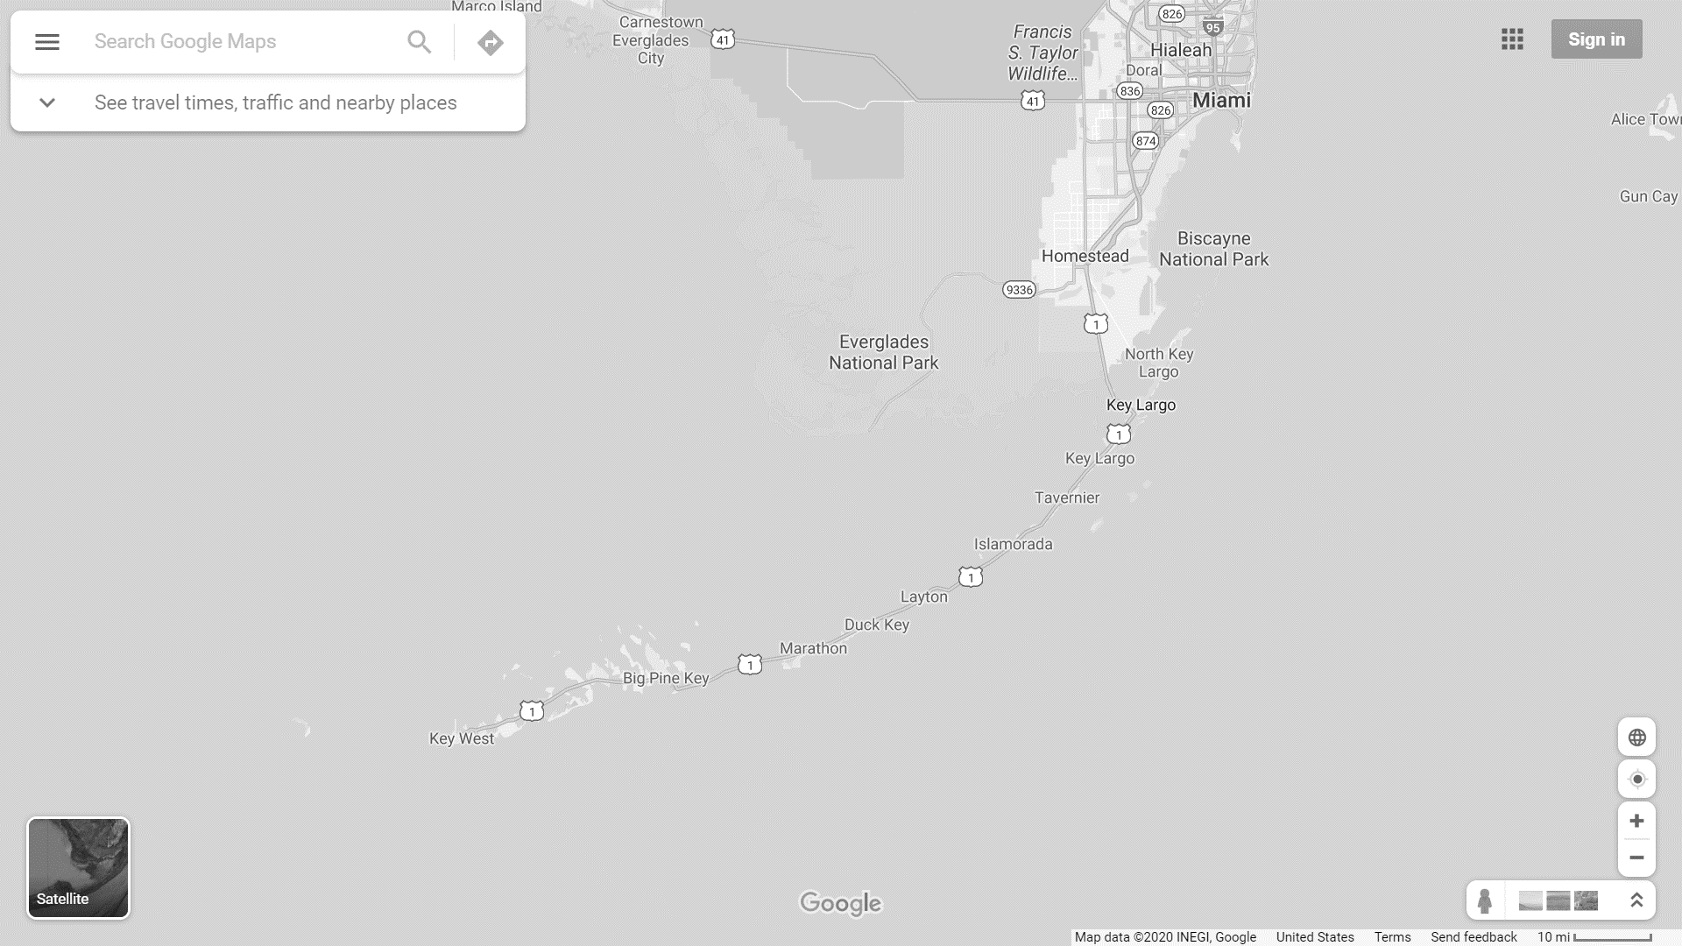
Notes:
Mile marker 0 signifies Key West, with mile marker 55 signifying my home town. Mile marker 100 is located at Key Largo.

Slide 22
Notes:
Within this Canvas example, the “Start Here” page serves as a “sign post” letting students clearly know how to begin. The “End of Introduction” page also serves as a sign post, indicating how students are progressing in the course.

Slide 23
Notes:
This text indicates where students are in relation to other course content and elaborates on how to navigate the content.

Slide 24
Notes:
Note: If you want students to click on the “Syllabus” option first, and then go to “Modules”, indicate that clearly here.

Slide 26
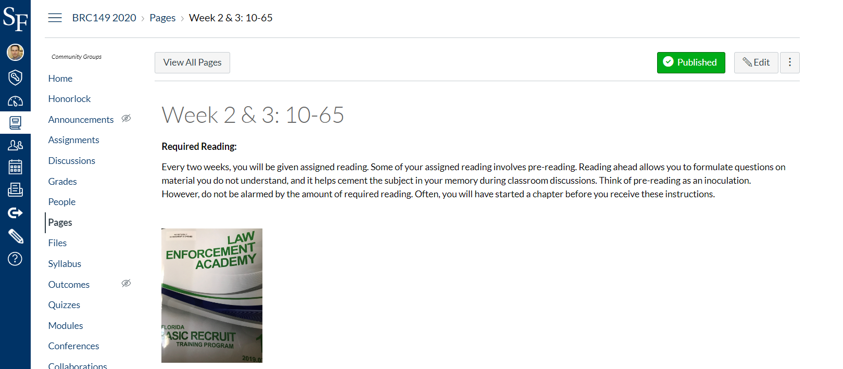

Slide 27
Rubrics
Indicate how student work is evaluated
Provide clarity to students
Help instructors prioritize and weight aspects of student work
Can improve the efficiency of grading

Slide 29
Use a Variety of Media
Universal design
Strive to provide content in text, images, audio and video
Appeals to a wider audience of learners
No time to create? Curate!
Consider starting with shorter videos
Like *really* short videos (30 to 60 second module overviews)
Even short videos go a long way towards establishing social presence
Video assignment feedback is possible in Canvas too
Notes:
Use phone, demo recording a short video module overview.

Slide 30
Basic Recording Tools
Canvas built-in recorder
Records video from computer webcam or smart phone
Great for creating a personal touch
Ideal for videos in shorter duration (under a few minutes)
Add video to announcements, pages, discussions, assignments, etc.
Let’s see how it works!
PowerPoint screen recorder
Records audio narration and computer content
Ideal for videos under 10 minutes in duration
Great for explaining content you may have in presentation slides
Let’s see how it works!
Smart phone

Slide 31
Smart Phone Considerations
Most smart phones have good recording quality
Record in a quiet environment
Be aware of lighting (light subject from front)
Use lower resolution settings
Canvas single file upload limit is 500 mb
For larger files, upload to YouTube/Vimeo or use Zoom*
Notes:
* If you are already using Zoom, use Zoom for lengthier recordings

Slide 32
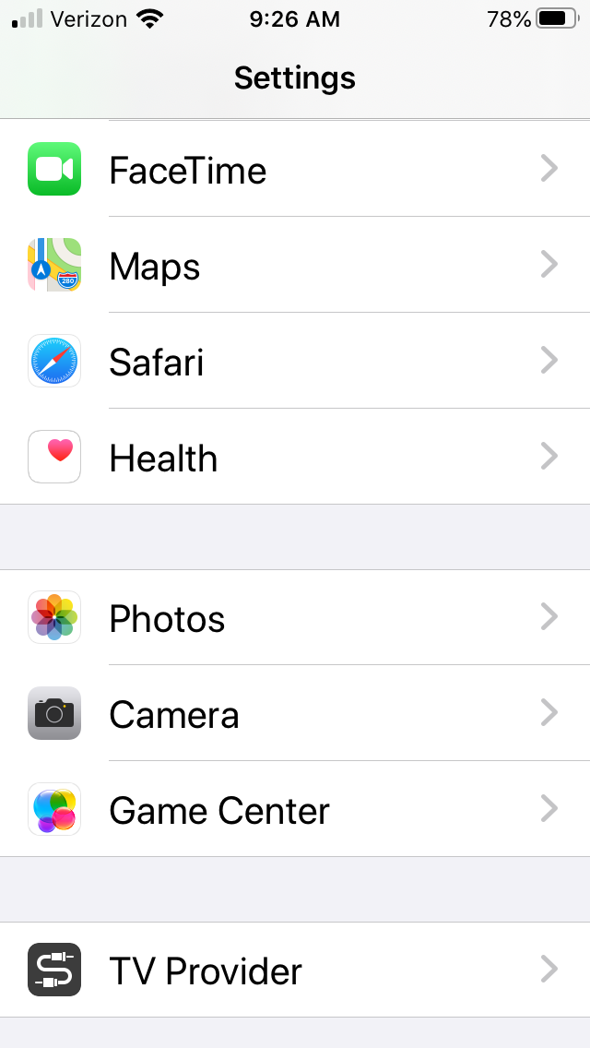
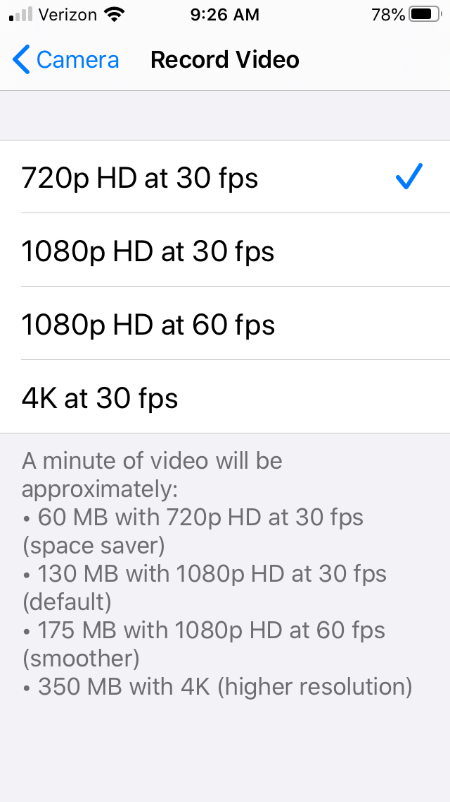
Smart Phone Settings Example
To upload directly into Canvas, file size must be under 500 mb.
Notes:
While Canvas limits single file uploads to 500 mb, you can upload longer content into YouTueb/Vimeo. Regardless of technical restrictions, it’s a good idea pedagogically to provide video content in chunks or segments at about 10 minutes or less. 8 minutes at the lowest (720p) setting.

Slide 33
Zoom and Recording
If you are already using Zoom for live class sessions:
Zoom best for videos longer than 10 minutes in duration
Try to keep duration under 15 minutes
More compelling content can go longer (i.e., interviewing a guest speaker)

Slide 34
Accessibility Tips
Search for video content that includes accurate captions, punctuation and capitalization
If creating your own video content, start by writing a script
Be explicit in describing the visuals and how they connect with the content

Slide 35
Notes:
For example, we might describe this photo with a young person with two thumbs up standing on top of a mountain overlooking clouds. A mountain peak above the clouds. Rays of sunlight break through the clouds.

Slide 36
Image Repositories
Enhance your content with engaging visuals
www.pixabay.com (check attributes)
www.unsplash.com (all free, uncredited use permitted)
Strive to include imagery of underrepresented individuals
www.nappy.co “High-res Photos of Black and Brown People”
www.genderphotos.vice.com “The Gender Spectrum Collection”
www.flickr.com/photos/wocintechchat “Women of Color in Tech”

Slide 37
Providing Multiple Means of Assessments
Course surveys
Quizzes (graded and un-graded)
Discussions
Assignment submissions
Tests
Projects

Slide 38
Notes:
Mile marker 0 signifies Key West, with mile marker 55 signifying my home town. Mile marker 100 is located at Key Largo.

Slide 39
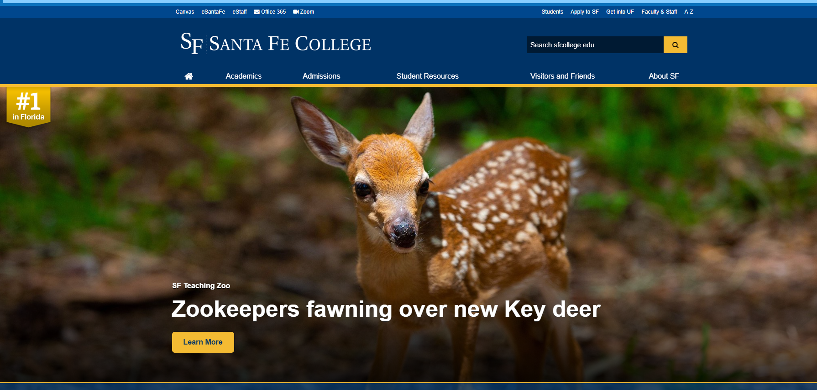
Notes:
It’s just too cute !

Slide 40
End of Webinar
Thank you for joining today!
Notes:
Thank you for joining!

