Slide 1
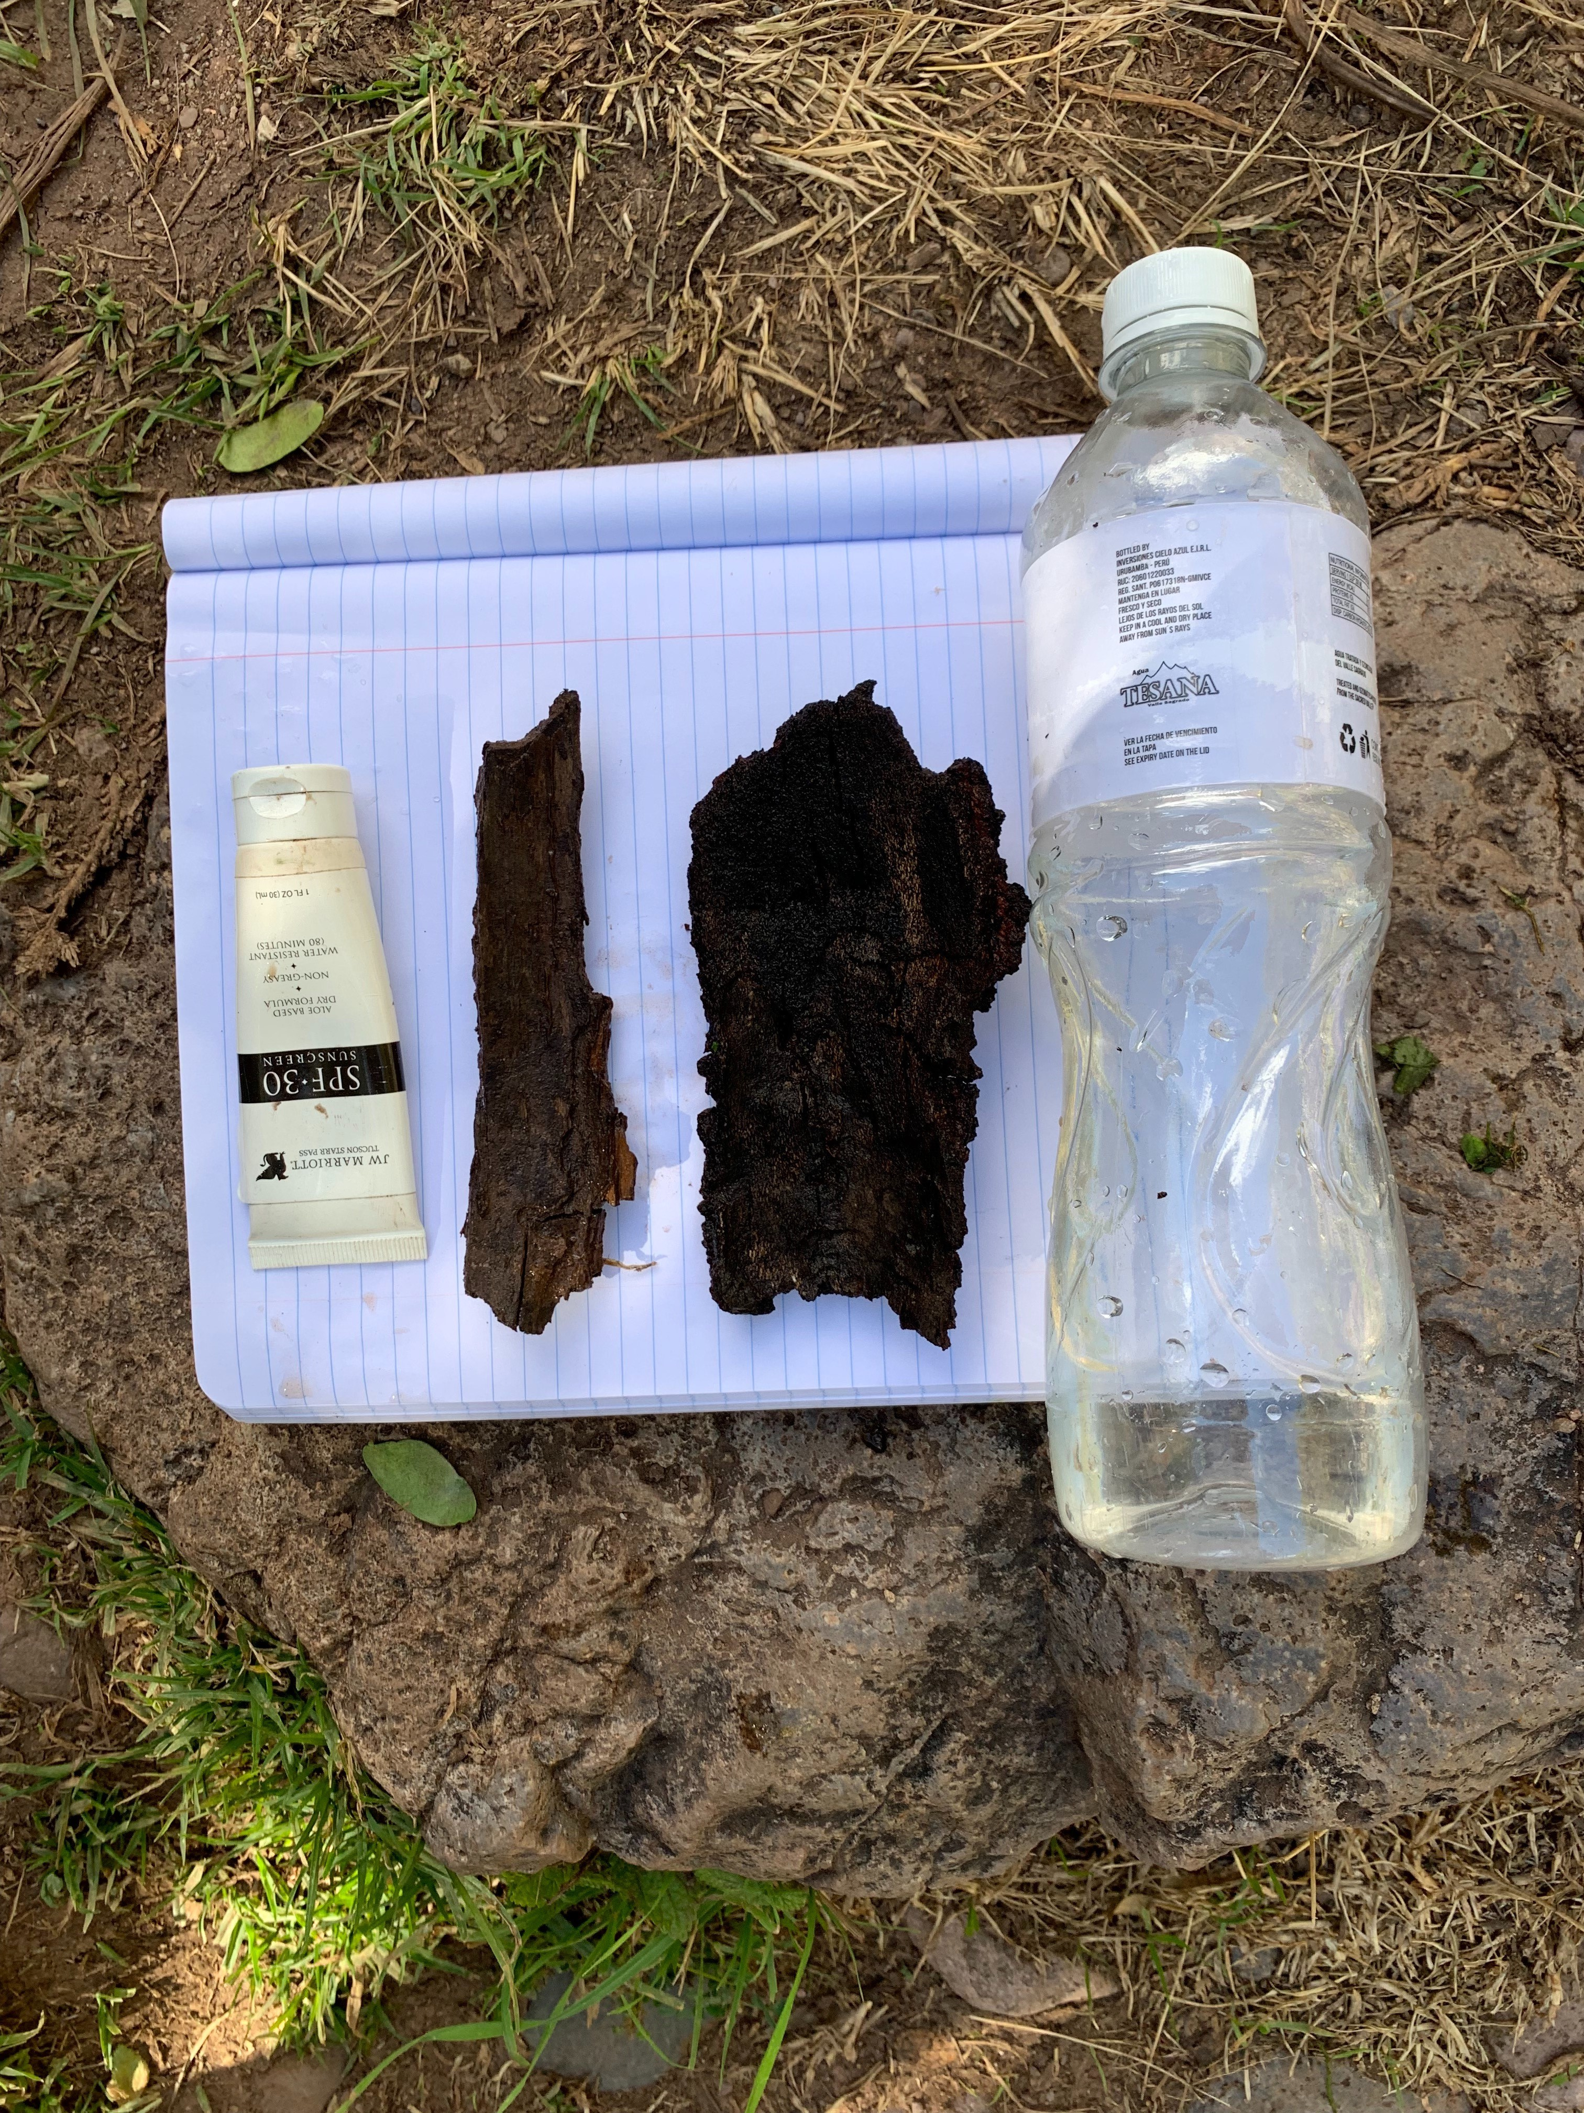
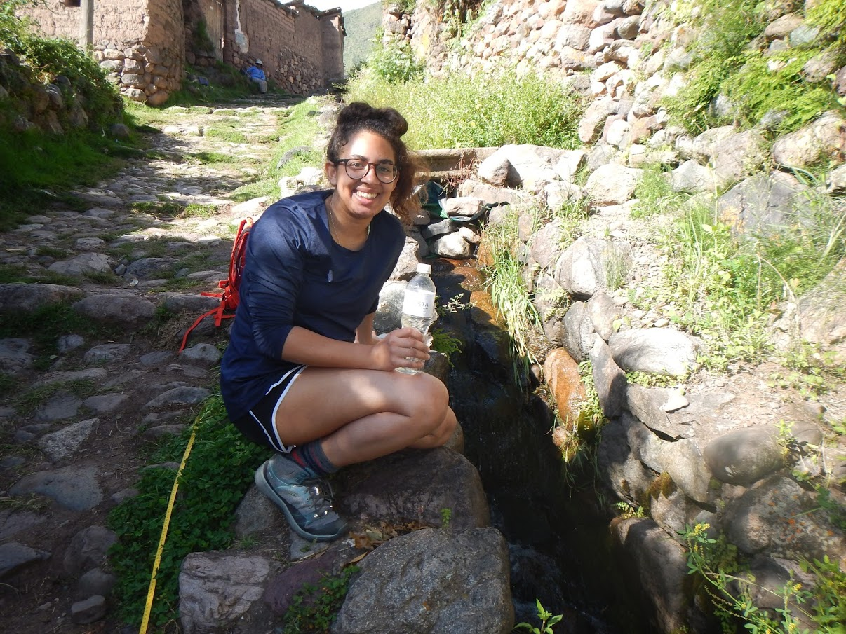
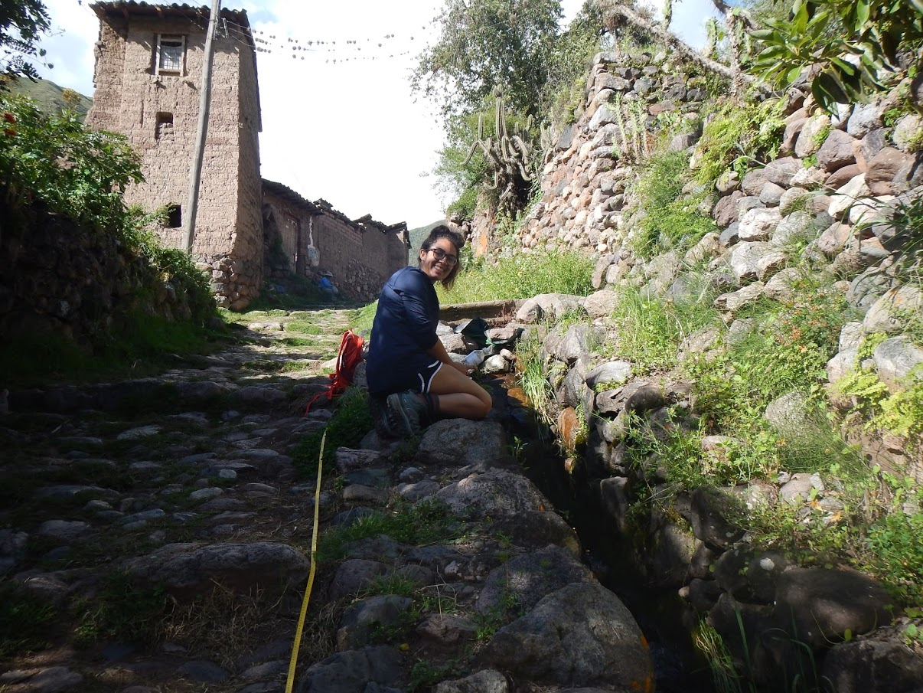
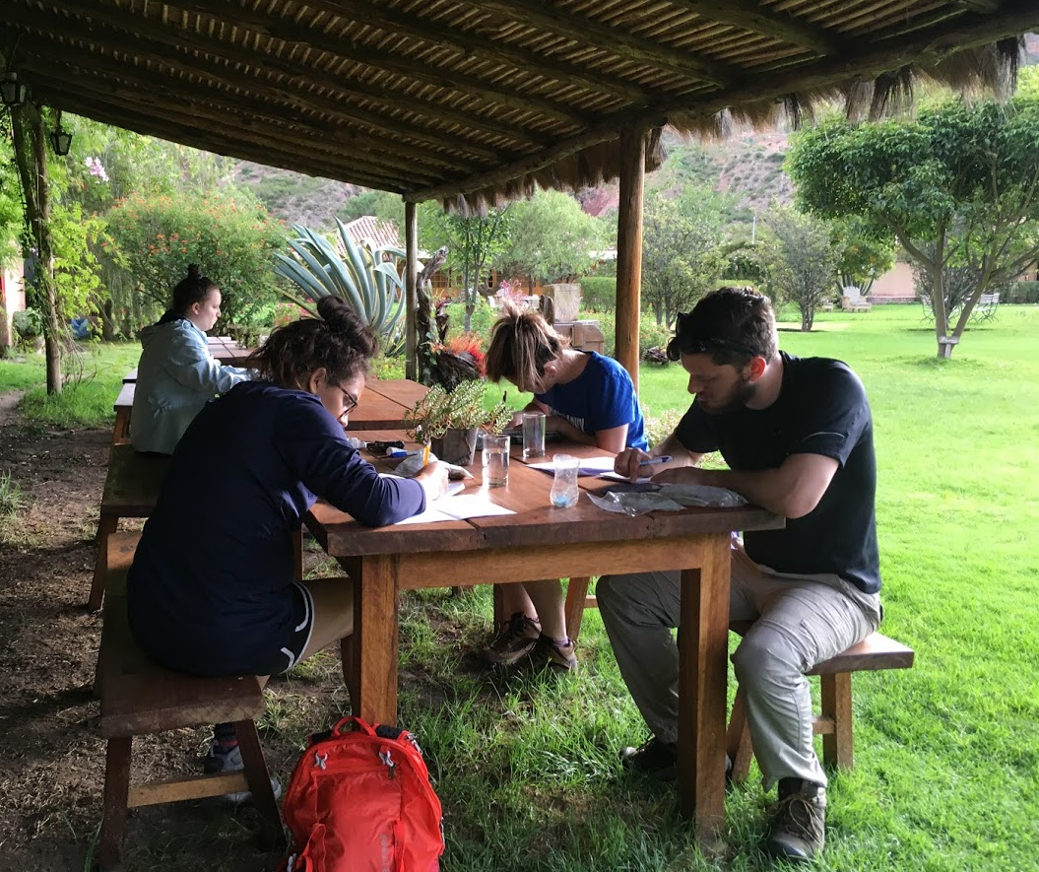
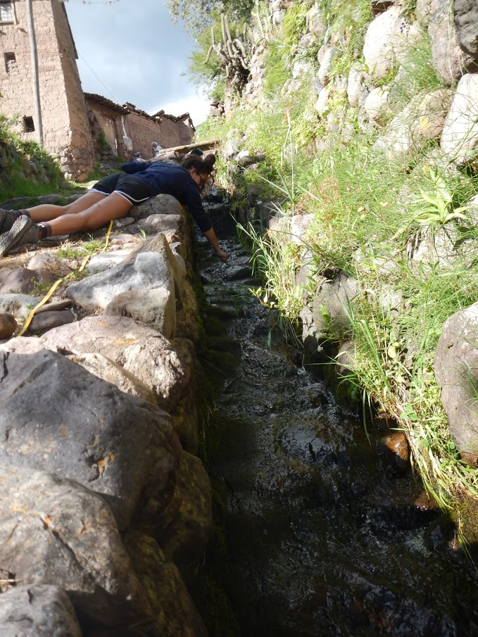
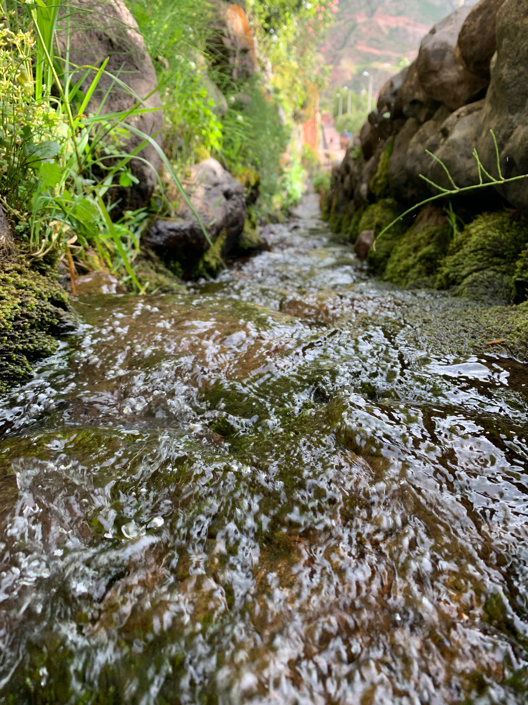
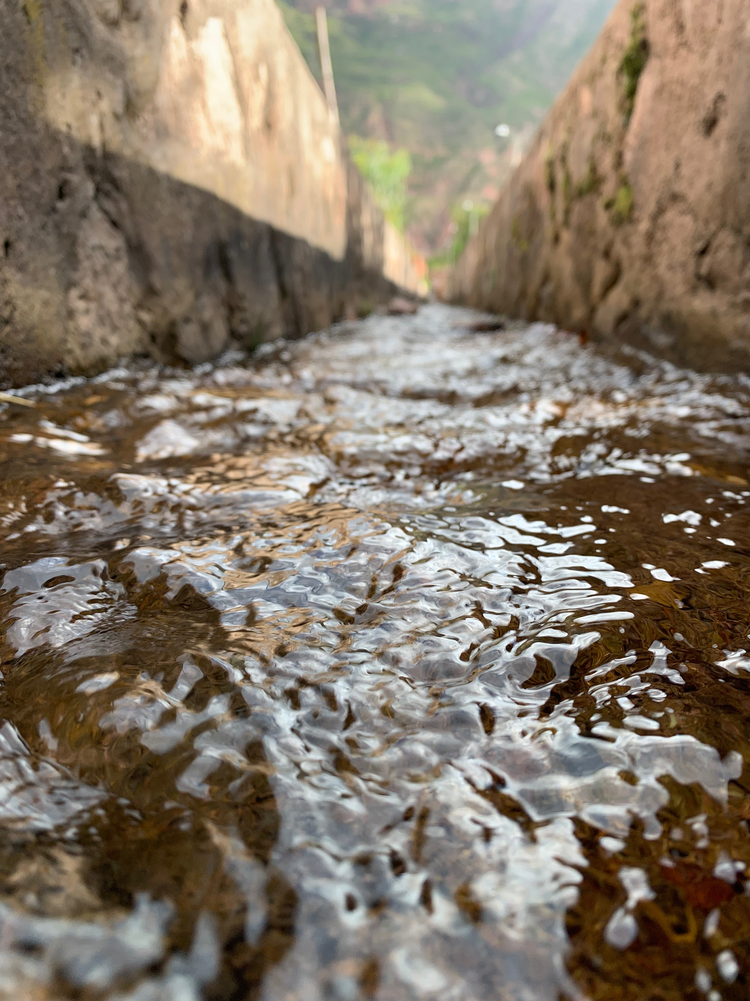
Discharge Velocity (Stream Flow) Variations in Peruvian Incan Aqueducts
Cassia Raina Barnard- Royer, Santa Fe College
Methods
Fig. 3. The cross-sectional area and average velocity of a stream can change in short distances, but the volume of water passing through cross section remains the same.
Sampled different test tools (floats)
Measured same length of steep and gentle testing sites
Took 14 sample runs at each location
Timed length of travel time from start to finish
Data Analysis
Discussion
Introduction
The discharge velocity of the steeper slope is significantly greater than the gentle slope. In this experiment the steeper slope had a more defined channel. Upstream flow was sinuous defined by raised rocks and algae. However, the channel was narrower and flowed more rapidly than the wide gentle sloped channel. Friction with bed and banks was higher in the more gentle the slope. Internal friction did not lower the velocity in the steeper slope, refuting Leopold and Maddock’s theory.
Water moves slower the closer it is to river bed and banks (Fig.1). Friction with the banks and bed causes water resistance. Turbulence, the violent movement of water, causes water to move irregularly as it travels downstream. Discharge (water flow) is constant so velocity is measured to determine which profile, steep or gentle, is most impacted by friction. Leopold and Maddock (1953) established that downstream gentler gradients exhibit less friction and turbulence and so higher mean velocity. This study tests this long established theory in Incan aqueducts.
Fig. 2. The steeper slopes discharge velocity is greater then gentler slope.
Results
The discharge velocity of the steeper slope, 2.09 +/- 0.84 seconds/per meter is significantly greater than a gentler slope of 2.87 +/- 0.61 seconds/per meter. (a=0.1, n=14, T-test), refuting Leopold and Maddock’s theory.
Fig. 1. Velocity flow is greatest in the middle and at the top of the stream.
Steep channel cross section (Left) Gentle channel cross section (right)
References
Bloom, L. A. (1998). Geomorphology A Systematic Analysis of Late Cenozoic Landforms. Long Grove, IL: Waveland Press, Inc.
Strahler, A. (2011) Introducing Physical Geography. Hoboken, NJ: John Wiley & Sons, Inc.
Leopold, L. B., and Maddock T., (1953). Hydraulic geometry of stream channels and some physiographic implications: US Gelo. Survey Prof. Paper 252, 57 pp.
Mentors: Heidi Lannon & Denise Guerin

